Slide 1
Unit 2

Slide 2
Topic Covered
1. Black- Box Model of Agent
2. Intentionality and Goals
3. Games, Search, Heuristic and Pruning
4. Strategies Rules
5. Making Simple Game- Playing Agent for TTT
6. Evaluation Functions, Utilitarian, Decision Making, Planning, Internal Representation

Slide 3
1. Black-Box Model of Agent
An agent is anything that can be viewed as perceiving its environment through sensors and acting upon that environment through actuators.
Agent | Human | Machine
Sensors | Eyes, ears, other organs | Cameras, IR finder
Actuators | Hands, legs mouth, other body parts | Various motors for actuators
Percept
Environment
Agent [Sensors]
[Actuators]
Actions
Agent = architecture + programme

Slide 4
Agent
Rational Agent
- Striving to do the right thing based on what it perceive and the action it can perform
-Performance Measure: An objective Criterion for success of an agent’s behaviour.
Ex: Vacuum Cleaner : - amount of dirt cleaned, amount of time consumed, amount of electricity consumed, amount of noise generated, etc.
Intelligent Agent : Self Driving Car:
PEAS(Performance, Environment, Actuator, Sensors)
P: Safe, Fast, Legal, comfortable trip, maximize profit
E: Road, Other Traffics, Pedestrians, Customers
A: Steering Wheels, accelerator, brake, signal, horn
S: Cameras, Sonar, Speedometer, GPS, Odometer, Engine sensors, keyboard

Slide 5
Agent
Types of Environment
Fully observable (vs. partially observable): An agent's sensors give it access to the complete state of the environment at each point in time.
Deterministic (vs. stochastic): The next state of the environment is completely determined by the current state and the action executed by the agent. (If the environment is deterministic except for the actions of other agents, then the environment is strategic)
Episodic (vs. sequential): The agent's experience is divided into atomic "episodes" (each episode consists of the agent perceiving and then performing a single action), and the choice of action in each episode depends only on the episode itself.
Static (vs. dynamic): The environment is unchanged while an agent is deliberating. (The environment is semi-dynamic if the environment itself does not change with the passage of time but the agent's performance score does)
Discrete (vs. continuous): A limited number of distinct, clearly defined percepts and actions.
Single agent (vs. multi-agent): An agent operating by itself in an environment.

Slide 6
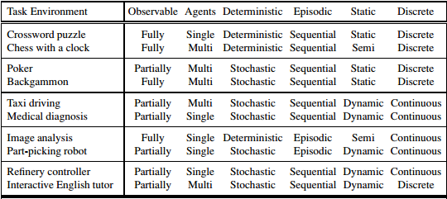

Slide 7
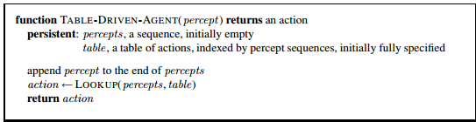
Agent Programme: takes the current percept as input from the sensors and return an action to the actuators.
The TABLE-DRIVEN-AGENT program is invoked for each new percept and returns an action each time. It retains the complete percept sequence in memory
Notes:
Notes about this is in word file

Slide 8
Agent
Four basic types in order of increasing generality:
• Simple reflex agents
• Model-based reflex agents
• Goal-based agents
• Utility-based agents
• Learning Agent [Self-Study]

Slide 9

Agents
Simple Reflex Agent
These agents select actions on the basis of the current percept, ignoring the rest of the percept history
Ex: Vacuum Cleaner : its decision is based only on the current location and on whether that location contains dirt
Notes:
Figure in Figure folder

Slide 10
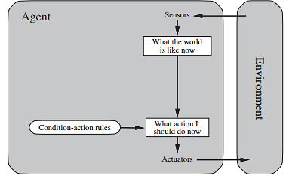
Agent
Simple Reflex Agent
condition–action-rule
if car-in-front-is-braking then initiate-braking
Limited intelligence

Slide 11
Agent
Model Based Agent
The most effective way to handle partial observability is for the agent to keep track of the part of the world it can’t see now. By maintaining Internal State
how the world works:???

Slide 12
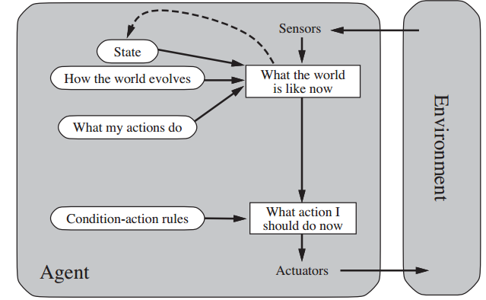
Model Based Agent

Slide 13
Agent
Goal Based Agent
Knowing something about the current state of the environment is not always enough to decide what to do. For example, at a road junction, the taxi can turn left, turn right, or go straight on. The agent needs some sort of goal information that describes situations that are desirable

Slide 14
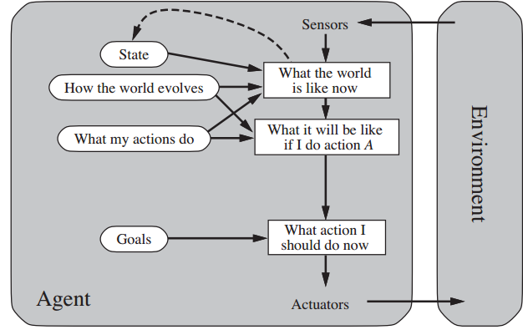
Agents
Goal Based Agent
It keeps track of the world state as well as a set of goals it is trying to achieve, and chooses an action that will (eventually) lead to the achievement of its goals.
Searching and Planning is mandatory
“What will happen if I do such-and-such?” and “Will that make me happy?

Slide 15
Agents
Utility Based Agent
Goals alone are not enough to generate high-quality behavior in most environments. For example, many action sequences will get the taxi to its destination (thereby achieving the goal) but some are quicker, safer, more reliable, or cheaper than others.
Goal Achieved or not????
Happy or Unhappy

Slide 16
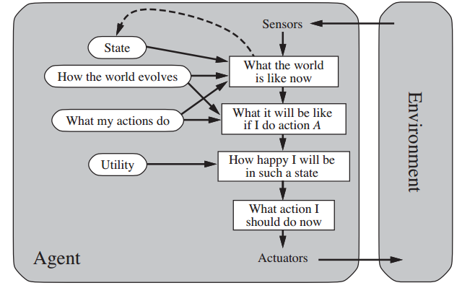
Agent
Utility Based Agents
It uses a model of the world, along with a utility function that measures its preferences among states of the world. Then it chooses the action that leads to the best expected utility, where expected utility is computed by averaging over all possible outcome states, weighted by the probability of the outcome

